Slide 1
The Ariba Network
Bidding for a Sourcing Event

Slide 2
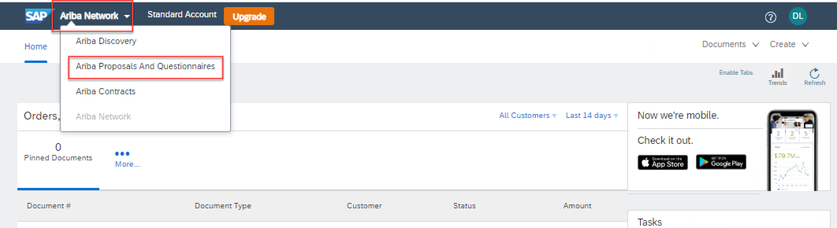
Supplier Registration Workshop
Bidding for a Sourcing Event
Step1: To toggle from the Purchase Orders interface to the Sourcing interface
Go to supplier.ariba.com and log in using your Ariba account credentials
On top left, click on the arrow next to “Ariba Network” and choose “Ariba Proposals and Questionnaires”
You will be directed to the Sourcing interface

Slide 3
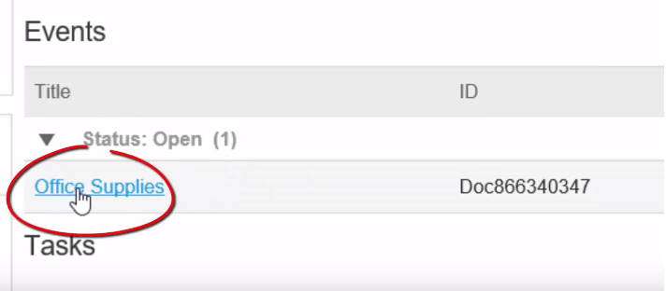
Supplier Registration Workshop
Bidding for a Sourcing Event
Step 2
Select the ‘Open Proposal’

Slide 4
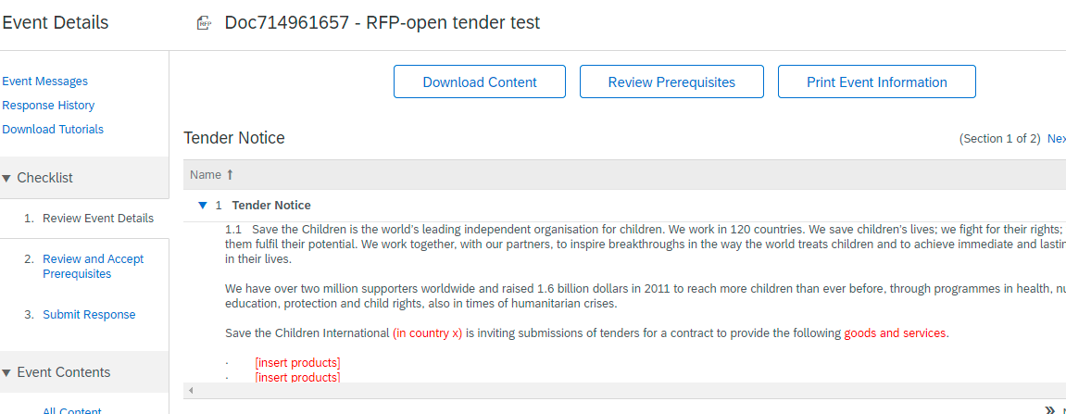
Supplier Registration Workshop
Bidding for a Sourcing Event
Step 3
Click on Review Prerequisites.

Slide 5
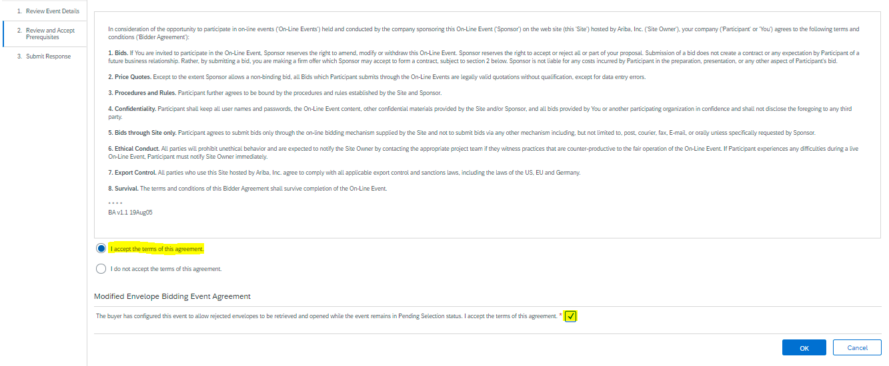
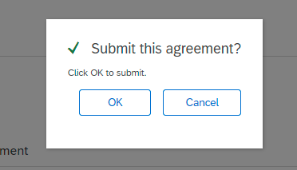
Supplier Registration Workshop
Bidding for a Sourcing Event
Step 4
You need to accept the Terms of the Agreement, and check the box under
“Modified Envelope Bidding Event Agreement”,Then Click “Ok” again on the popped up window.

Slide 6
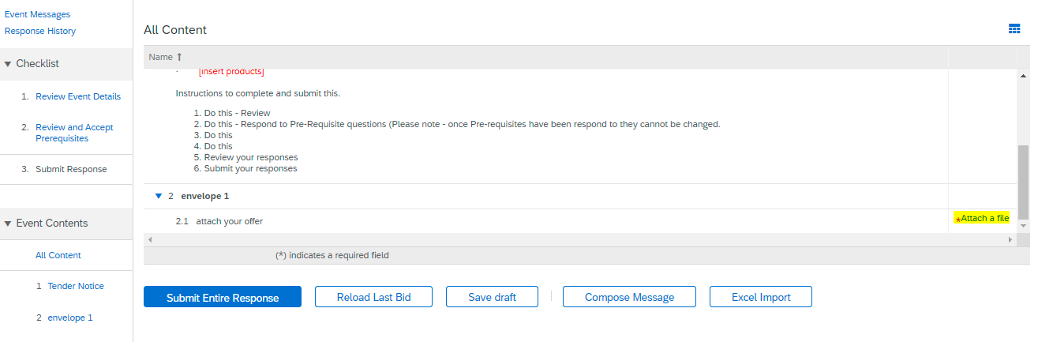
Supplier Registration Workshop
Bidding for a Sourcing Event
Step 5
Move to the next step: “Submit Response”, and Click on attach a file under the Envelope Section (Highlighted in Yellow)

Slide 7
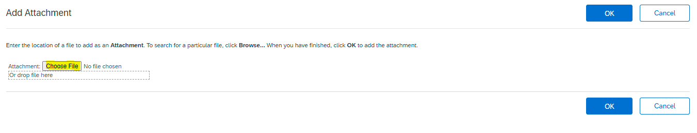
Supplier Registration Workshop
Bidding for a Sourcing Event
Step 6
Choose a File from your Desktop where you saved your offer , select it and click on “Ok”

Slide 8
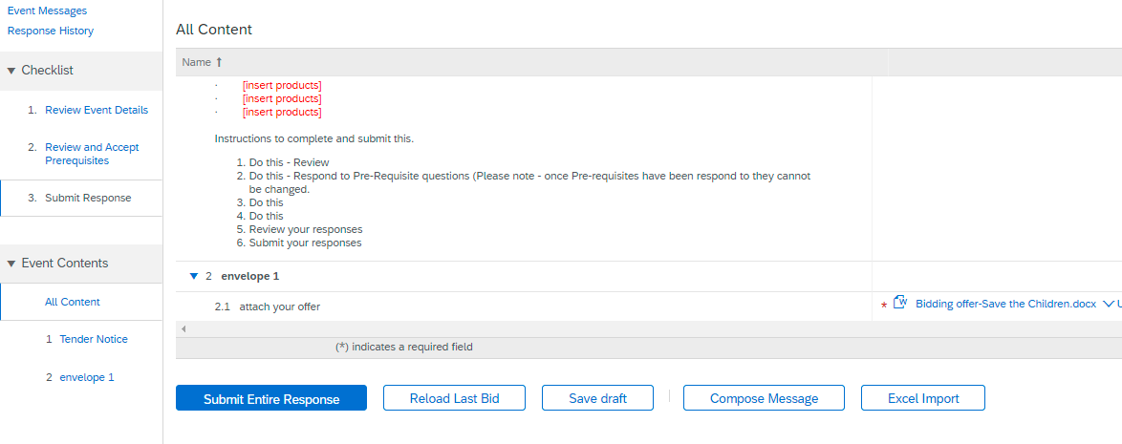
Supplier Registration Workshop
Bidding for a Sourcing Event
Step 7
Click on “Submit Entire Response” and click “Ok”

Slide 9
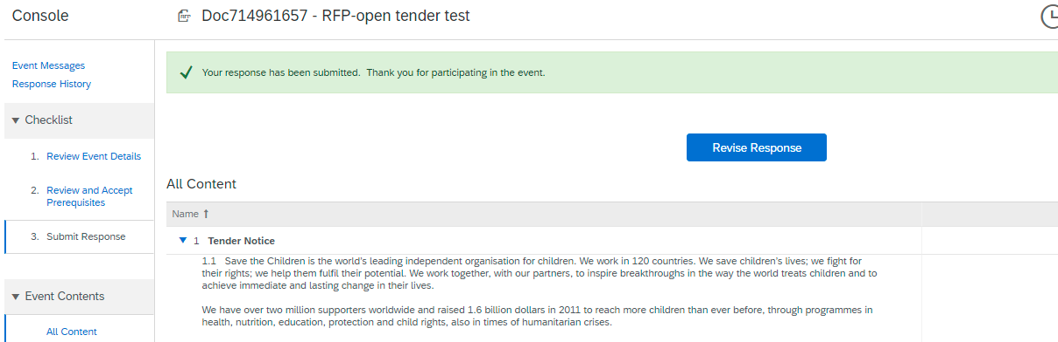
Supplier Registration Workshop
Bidding for a Sourcing Event
-You Have Successfully Participated in the Event.
-You can Revise your Response if you want to add or amend something in your offer, as long as the Event is still open, by clicking “Revise Response” Option as shown below.

Slide 10
Ariba Network Guidance
Support Available
If you have difficulties, and require technical support, you can access the Ariba Supplier Support Website on this link: https://www.ariba.com/support/supplier-support.
The Getting Started Page offers guidance on how to set up and navigate your new Ariba Network Account: https://www.ariba.com/ariba-network/ariba-network-for-suppliers/getting-started
The Ariba Network Quick Start Guide gives helpful instructions on how to use the service. Your SCI contact will provide you with a copy of this guide.

